Slide 1
Mortality Rates by Selected Causes from 1980-2014
Jonathan Stumpf | Maddie Warndorf | Olivia Zarroli

Slide 2
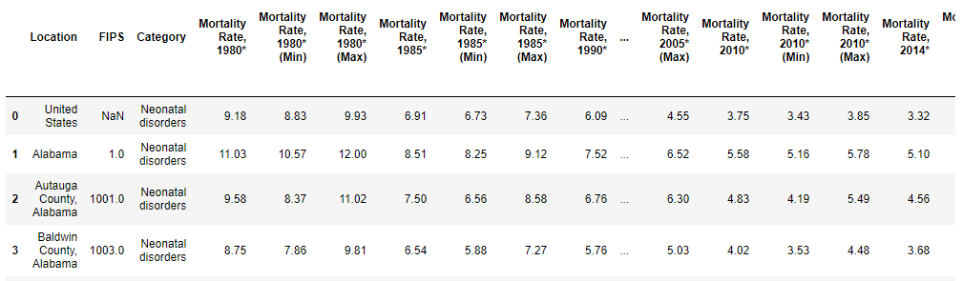
Objective and Introduction to Dataset
The dataset:
United States Mortality Rates by County 1980-2014
Downloaded from: https://www.kaggle.com/IHME/us-countylevel-mortality
Dataset cleaning:
The resolution of the dataset was very high, and offered at a county level for each State. To ensure that each datapoint was statistically significant (avoids counties with small populations), we chose to perform out analysis on a statewide level.
The raw dataset also offered metrics on 21 causes of mortality. Four causes were chosen for this analysis
Objective:
Analyze the following causes (neurological disorders, mental and substance use disorders, nutritional deficiencies, and self-harm and interpersonal violence) to see if the mortality rates are correlated across the United States as well as from 1980-2014.
Raw Dataset snippet

Slide 3
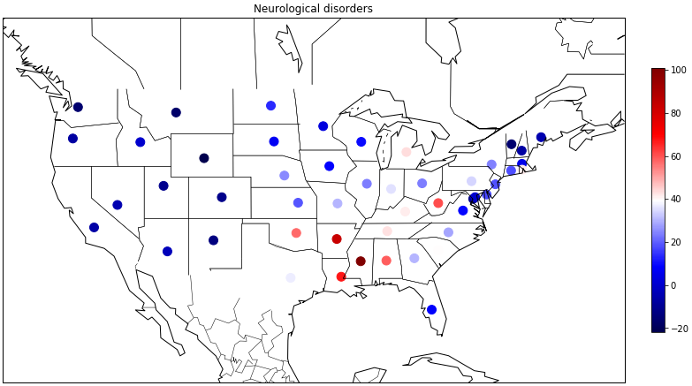
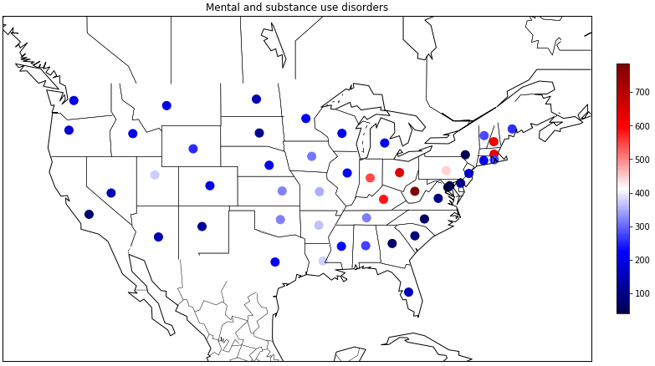
Neuro Disorder vs Mental and Substance Disorder Rate of Change
The top figure is a geo-plot showing the rate of change of mortality caused by Neurological Disorders between 1980-2014
The heat map (with respect to the color-scale) shows deaths by neurological disorders increasing in the midwest / southern regions.
The bottom figure is a geo-plot showing the rate of change of mortality caused by Mental and Substance Use Disorders between 1980-2014
The heat map (with respect to the color-scale) shows all states with increased deaths due to mental and substance abuse. Specifically, a pocket of severe increase can be seen between Indiana, Ohio, Kentucky and West Virginia.
A visual comparison of the plots suggest that a correlation between neuro disease and substance abuse deaths exists

Slide 4
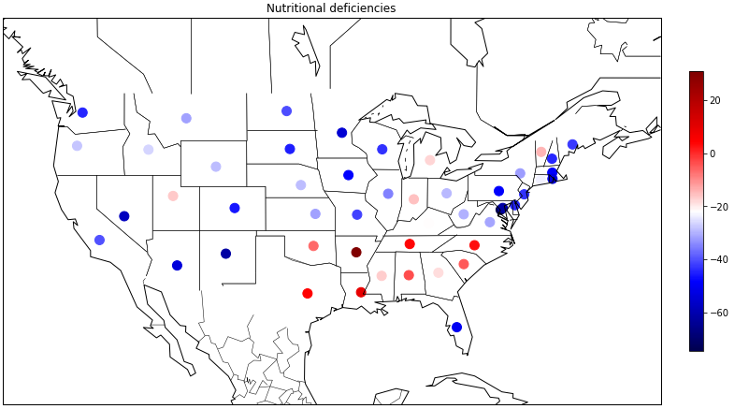
Neuro Disorder vs Nutritional Deficiency Rate of Change
The top figure is a geo-plot showing the rate of change of mortality caused by Neurological Disorders between 1980-2014
The heat map (with respect to the color-scale) shows deaths by neurological disorders increasing in the midwest / southern regions.
The bottom figure is a geo-plot showing the rate of change of mortality caused by Nutritional Deficiency between 1980-2014
The heat map (with respect to the color-scale) shows deaths by nutritional deficiencies increasing in the midwest/southern regions.
A geographical correlation can be seen between Neurological Disorders and Nutritional Deficiency mortality rate, specifically in the South. This suggest that the two mortality causes may be correlated.

Slide 5
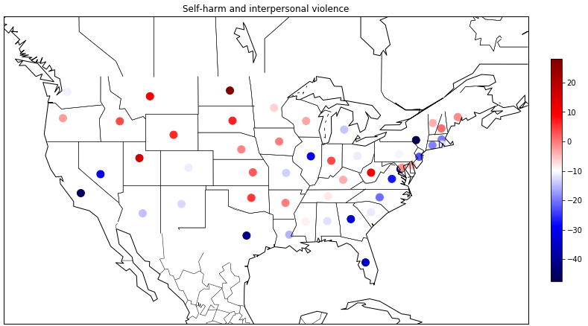
Neuro Disorder vs Self Harm Rate of Change
The top figure is a geo-plot showing the rate of change of mortality caused by Neurological Disorders between 1980-2014
The heat map (with respect to the color-scale) shows deaths by neurological disorders increasing in the midwest / southern regions.
The bottom figure is a geo-plot showing the rate of change of mortality caused by Self Harm and Interpersonal Violence between 1980-2014
The heat map (with respect to the color-scale) shows deaths by nutritional deficiencies increasing the most to the North
From a visual inspection, it does not seem that nuero disorders and self harm due to mortality are correlated in geography

Slide 6
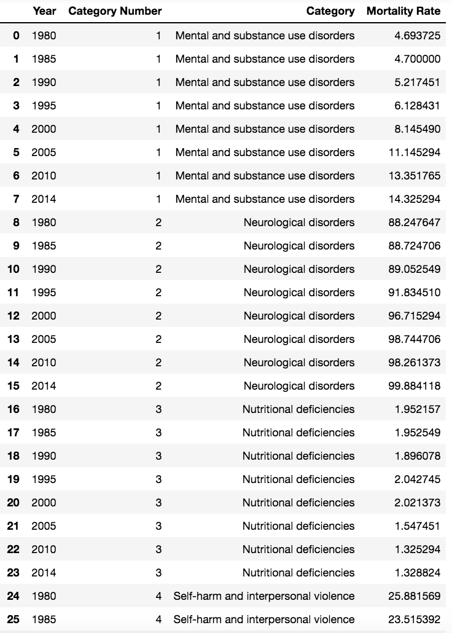
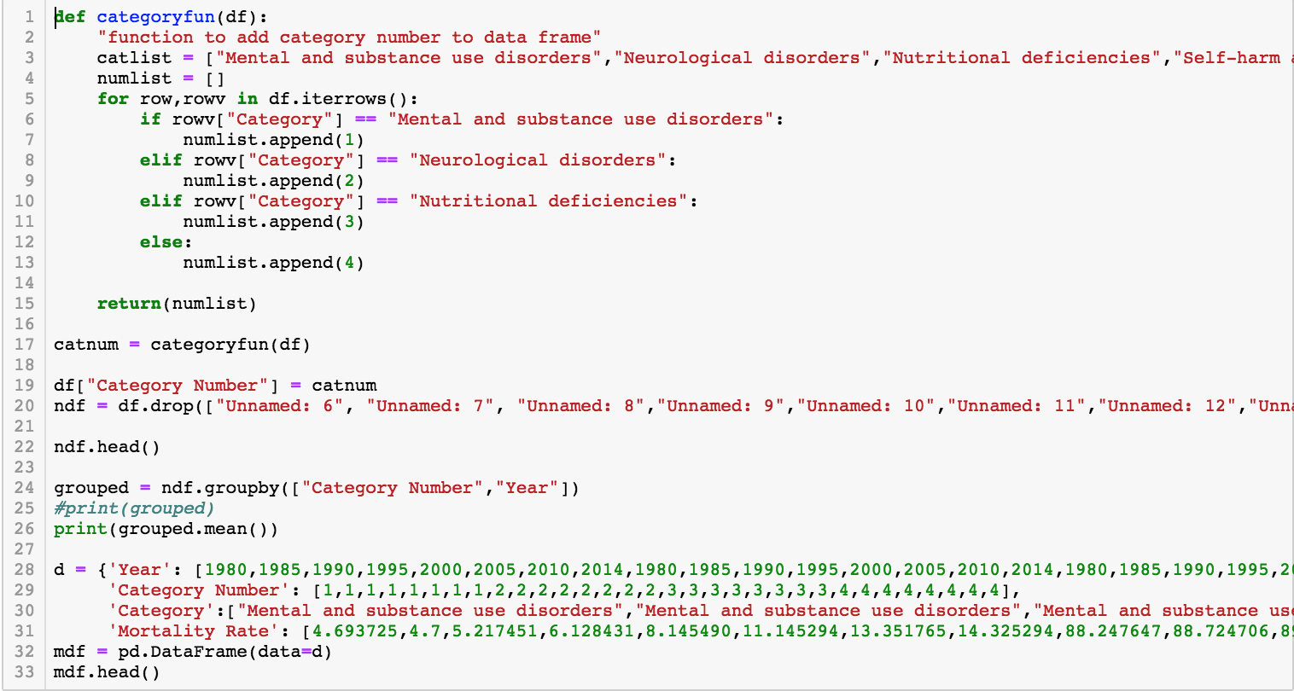
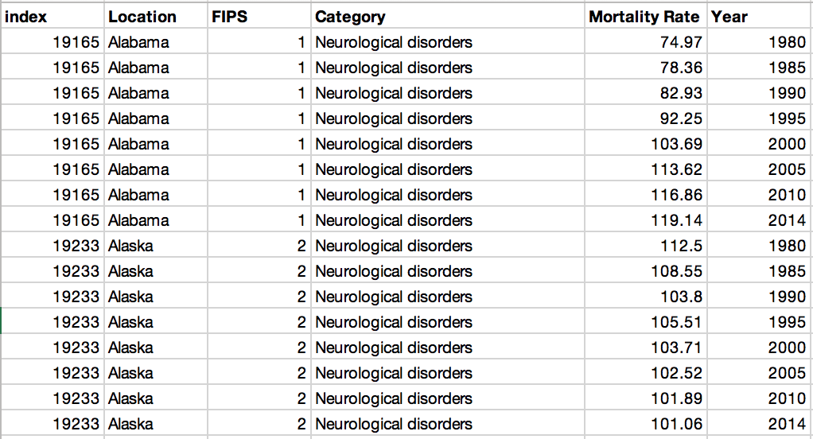
Time Series Analysis
Had to reshape the data in Excel so that included a “Year” column.
Added a column containing “Category Number”.
Focused on analyzing cause of death instead of state, so the data was grouped to find the mean of “Mortality Rate” based on “Category Number” and “Year”
New dataset was created using “Year”, “Category Number”, “Category”, and “Mortality Rate”.

Slide 7
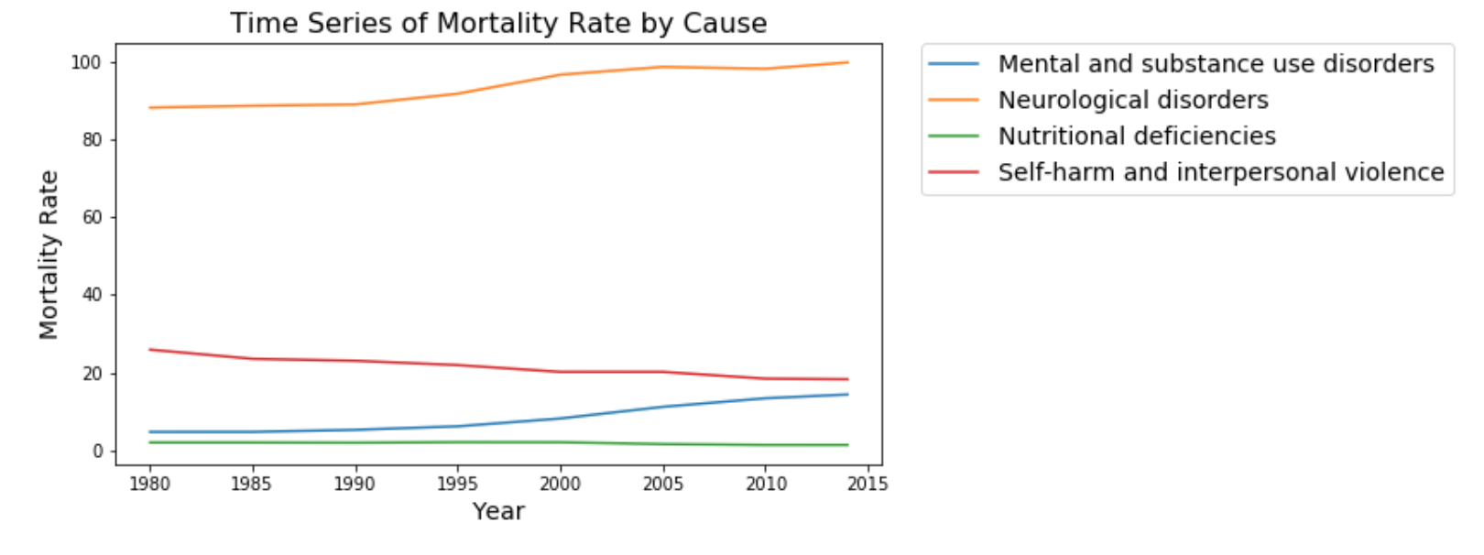
Time Series Analysis
There is an increase in the mortality rates in Neurological disorders and Mental and substance use disorders.
There is a decrease in the mortality rates in Self-harm and interpersonal violence and Nutritional deficiencies.
However, since the data is only by year it is hard to create a model or draw statistically significant conclusions without more data or the data being broken down by MM-YYYY.

Slide 8
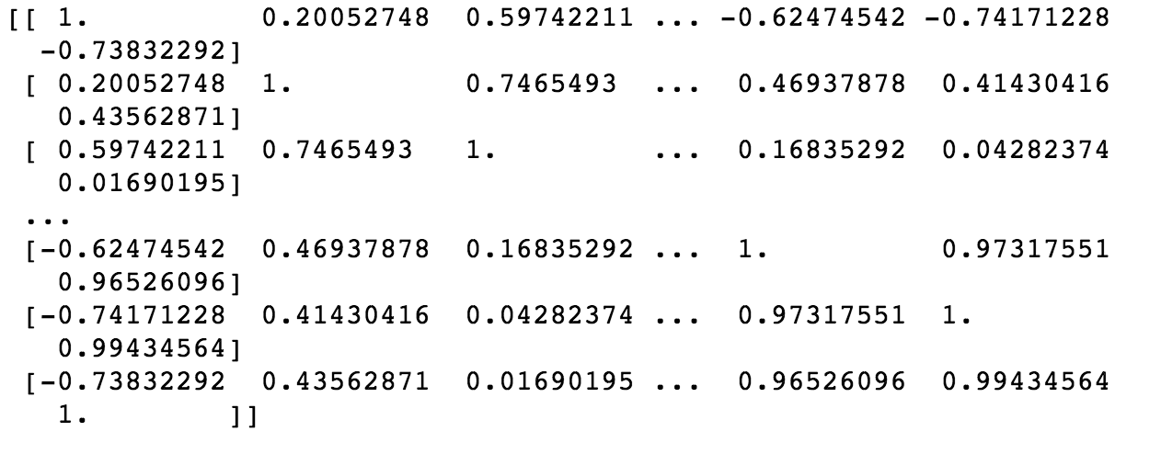
Correlation Coefficient
Using the cleaned data, I was able to enter the data into a matrix
Parsed the necessary rows and columns so that I was only using the mortality rates from 1980-2010 and not considering any of the percentages
Used np.corrcoef for the entire matrix
Put this data into a heat map to make more sense of it..

Slide 9
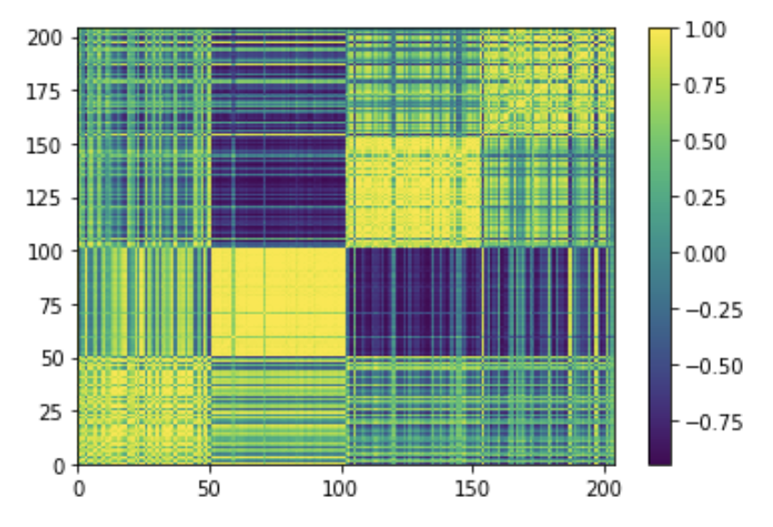
Heat Map of Correlation Coefficient
0-50: neurological disease deaths in each state
50-100: mental and substance use disorders
100-150: Nutritional deficiencies
150-200: Self-harm and interpersonal violence
In places where the blocks are most yellow, such as mental and substance use disorders, the trends over time throughout states are closely correlated. Where it is more muffled, as in nutritional deficiencies, the opposite is true.

Slide 10
Final Conclusions
Visual analysis (geo-location) of rate of mortality change by disease suggest that neurological disorders could be linked to nutritional deficiencies.
Visual analysis also suggests that substance abuse is increasing the most in a tight geo-centric location (Indiana/Kentucky/West Virginia/Ohio
Though the time series graph showed changes from 1980 to 2014, it is hard to create a model or draw statistically significant conclusions without more years included or the data being broken down by MM-YYYY.
We discovered that deaths as a result of mental and substance abuse disorders were the most correlated over time, and neurological diseases were not correlated at all.
Throughout the entire country, deaths as a result of mental and substance use disorders were most correlated. Self-harm and interpersonal violence was the least correlated cause of death among states.

